Slide 1
Systolic Arrays
Matrix Multiplication using
ES 204 : Digital Systems
Project
23110207: Mohit
23110329: Tanishq Bhushan Chaudhari
23110335: Tejas Lohia
23110373: Zainab Kapadia

Slide 2
Problem Statement
Implementation of 3 x 3 Matrix multiplication using systolic array and implementation of UART to operate these modules using a python script on a computer.

Slide 3
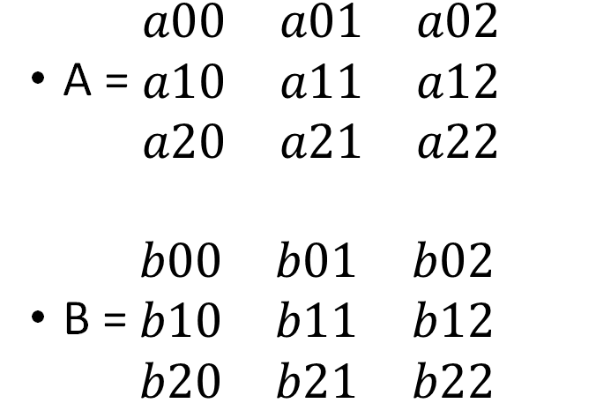
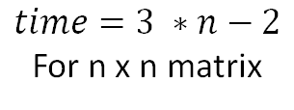
3 x 3 Matrix
A = $\begin{matrix}a00 & a01 & a02 \\ a10 & a11 & a12 \\ a20 & a21 & a22\end{matrix}$
B = $\begin{matrix}b00 & b01 & b02 \\ b10 & b11 & b12 \\ b20 & b21 & b22\end{matrix}$
$$time=3 ∗n−2$$
For n x n matrix
$$c= \begin{matrix}a00b00+a01b10+a02b20 & a00b01+a01b11+a02b21 & a00b02+a01b12+a02b22 \\ a10b00+a11b10+a12b20 & a10b01+a11b11+a12b21 & a10b02+a11b12+a12b22 \\ a20b00+a21b10+a22b20 & a20b01+a21b11+a22b21 & a20b02+a21b12+a22b22\end{matrix}$$

Slide 4
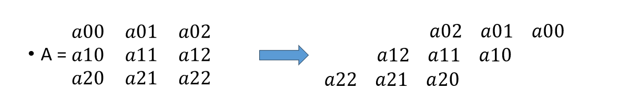

Slide 5
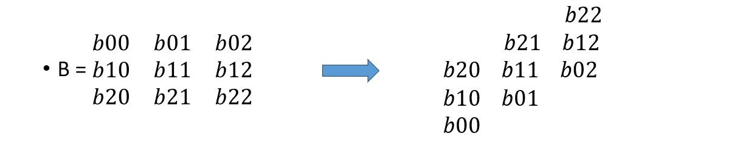

Slide 6
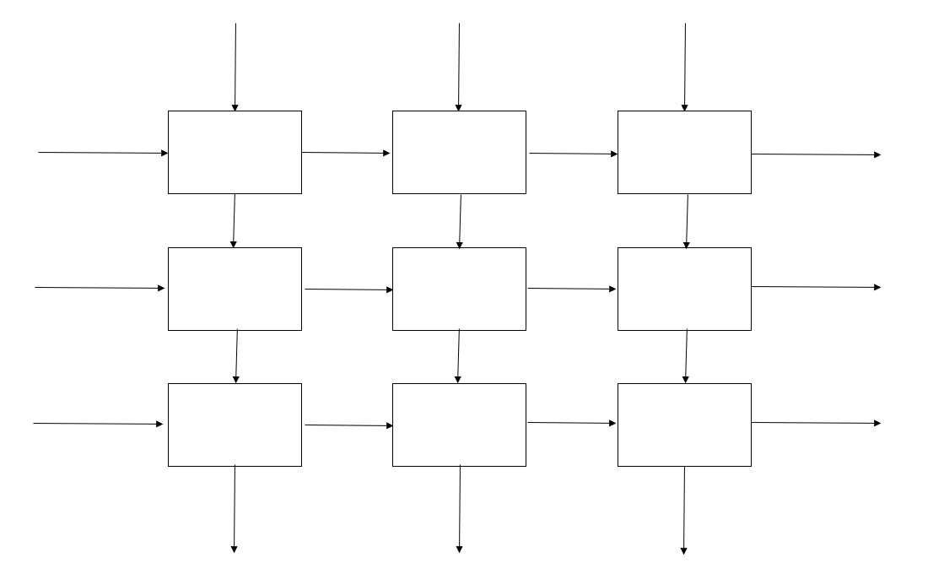
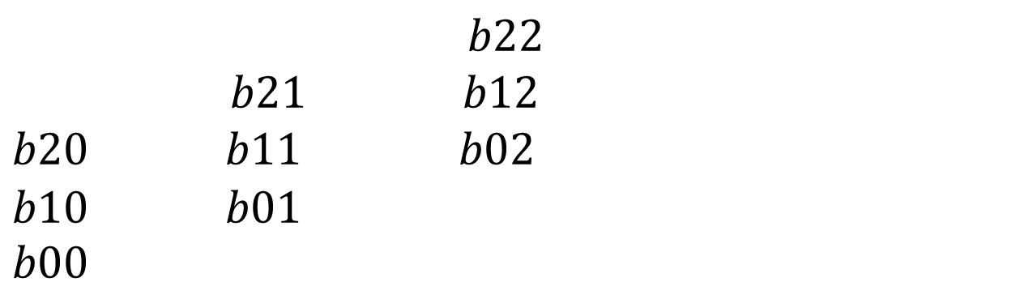
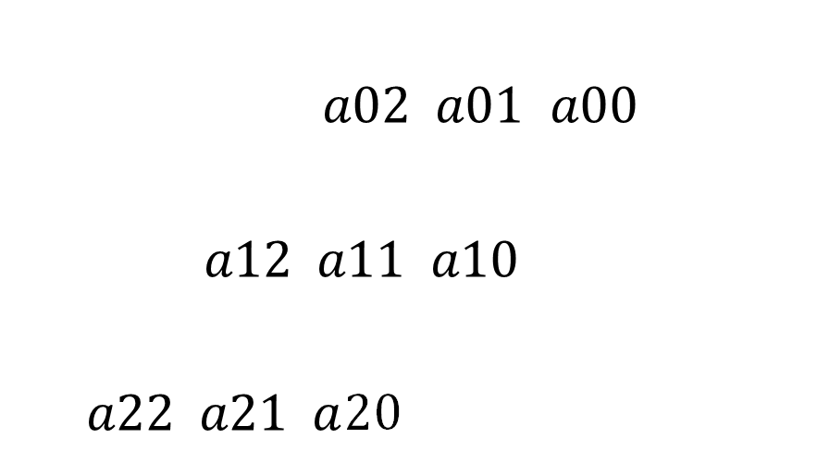
$$b22$$
$$b21 b12$$
$b20 b11$ $b02$
$$b10 b01$$
$$b00$$
$a02$ $a01$ $a00$
$a12 a11$ $a10$
$a22 a21 a$20

Slide 8
b00
a00
C=a00b00

Slide 9
b10
b01
a01
C=a00b00+a01b10
a00
C=a00b01
b00
a10
C=a10b00

Slide 10
b20
b11
b02
a02
C=a00b00+a01b10+a02b20
a01
C=a00b01+a01b11
a00
C=a00b02
b10
b01
a11
C=a10b00+a11b10
a10
C=a10b01
b00
a20
C=a20b00

Slide 11
b21
b12
C=a00b00+a01b10+a02b20
a02
C=a00b01+a01b11+a02b21
a01
C=a00b02+a01b12
a00
b20
b11
b02
a12
C=a10b00+a11b10+a12b20
a11
C=a10b01+a11b11
a10
C=a10b02
b10
b01
a21
C=a20b00+a21b10
a20
C=a20b01
b00

Slide 12
b22
C=a00b00+a01b10+a02b20
C=a00b01+a01b11+a02b21
a02
C=a00b02+a01b12+a02b22
a01
a00
b21
b12
C=a10b00+a11b10+a12b20
a12
C=a10b01+a11b11+a12b21
a11
C=a10b02+a11b12
a10
b20
b11
b02
a22
C=a20b00+a21b10+a22b20
a21
C=a20b01+a21b11
a20
C=a20b02
b10
b00
b01

Slide 13
C=a00b00+a01b10+a02b20
C=a00b01+a01b11+a02b21
C=a00b02+a01b12+a02b22
a02
a01
a00
b22
C=a10b00+a11b10+a12b20
C=a10b01+a11b11+a12b21
a12
C=a10b02+a11b12+a12b22
a11
a10
b21
b12
C=a20b00+a21b10+a22b20
a22
C=a20b01+a21b11+a22b21
a21
C=a20b02+a21b12
a20
b20
b10
b11
b00
b01
b02

Slide 14
C=a00b00+a01b10+a02b20
C=a00b01+a01b11+a02b21
C=a00b02+a01b12+a02b22
a02
a01
a00
C=a10b00+a11b10+a12b20
C=a10b01+a11b11+a12b21
C=a10b02+a11b12+a12b22
a12
a11
a10
b22
C=a20b00+a21b10+a22b20
C=a20b01+a21b11+a22b21
a22
C=a20b02+a21b12+a22b22
a21
a20
b20
b21
b10
b11
b12
b00
b01
b02

Slide 15
Implementation of Multiplication Module
Multiplication logic implemented using four modules.
PE module
Matrix_multiplication
SimplifiedMasterController
SystolicMatrixMultiplier

Slide 16
Multiplying array system
PE module
This Module is to define a single PE unit which performs the function to multiply and accumulate, and carry the output to the next PE modules
Matrix_multiplication
This module SystolicMatrixMultiplier coordinates matrix multiplication using a systolic array architecture. It connects a controller and computation unit to process 3×3 matrix inputs and produce a 3×3 output matrix

Slide 17
Controlling system
SimplifiedMasterController
The SimplifiedMasterController module controls the timing and flow of matrix data into the systolic array. It simulates the clock-by-clock feeding of matrix elements by sending appropriate values of matrices A and B into the array across multiple cycles, clearing the array initially and signaling completion with a done flag at the end of the data transfer process.
SystolicMatrixMultiplier
The SystolicMatrixMultiplier is the main module that controls the entire matrix multiplication process. It coordinates between the controller and the systolic array to perform 3×3 matrix multiplication and outputs the final result along with a done signal.

Slide 18
Input / Output for Multiplying Modules
Clk, reset, clear, in_a, in_b
Out_a, out_b, out_c
PE module
Input
Output

Slide 19
Input / Output for Multiplying Modules
Clk, reset, clear, a1, a2, a3, b1, b2, b3
c1, c2, c3,c4, c5, c6, c7, c8, c9
matrix_multiplication
Input
Output

Slide 20
Input / Output for Multiplying Modules
Clk, reset, clear, A00, A01, A02, A10, A11, A12, A20, A21, A22, B00, B01, B02, B10, B11, B12, B20, B21, B22
C00, C01, C02, C10, C11, C12, C20, C21, C22
SystolicMatrixMultiplier
Input
Output

Slide 21
Input / Output for Multiplying Modules
Clk, reset, clear, A00, A01, A02, A10, A11, A12, A20, A21, A22, B00, B01, B02, B10, B11, B12, B20, B21, B22
a1, a2, a3, b1, b2, b3, done, clear
SimplifiedMasterController
Input
Output

Slide 22
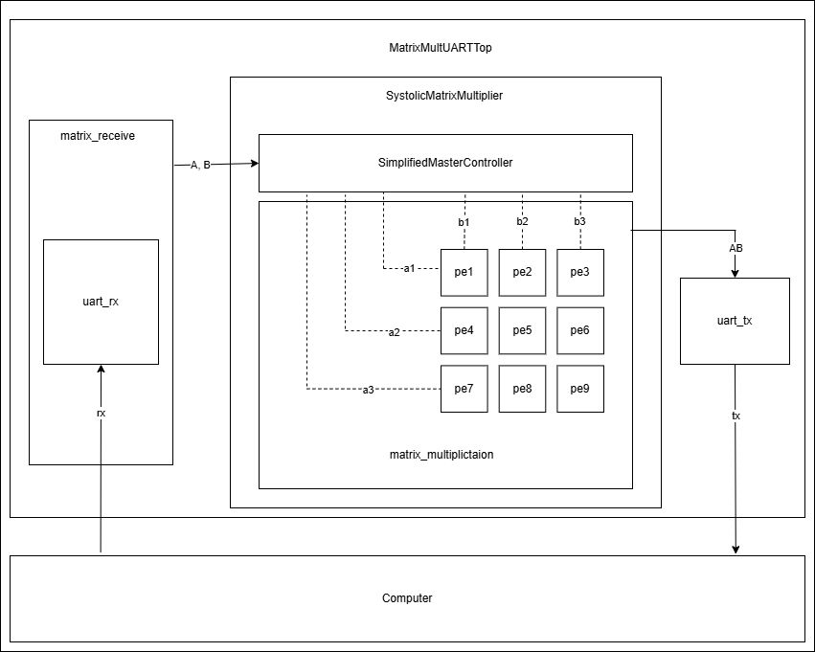
Block diagram

Slide 23
UART base Modules
uart_rx : This module reads rx line and based on baud rate, clock and oversampling rate returns am 8-bit number using majority voting and oversampling.
uart_tx : This module takes an 8-bit number as input and based on the baud rate and clock, toggles tx for transmission of this number after receiving a high signal in input tx_start.

Slide 24
Controlling and Top Modules
matrix_receive : Using the uart_rx module it reads and outputs the 18 input numbers ( 9 from each input matrix) from the rx line.
MatrixMultUARTTop : This is the top module integrating the UART architecture with the SystolicMatrixMultiplier module. It takes rx as input from which it reads all the inputs and after multiplication, returns each element of the output matrix in 3 byte representation on tx.

Slide 25
Error/Problems faced in Multiplications
To pass values to the Processing Elements (PEs), we considered two approaches:
Store all input values initially, and then update the variables a1, a2, a3, b1, b2, b3 after each cycle (i.e., after each round of passing values to the PE's).
Process inputs incrementally by accepting one set of values, running a cycle, and then repeating this process until all input values are exhausted.
We chose the first approach, as in real-world scenarios, input values are typically made available all at once rather than being passed incrementally.

Slide 26
Unique Approaches
We broke down our code into many modules which perform different functions and dependent on each other for task. We also made use of MasterController and Simplified MasterController modules to control and update flow of data.

Slide 27
Error/Problems faced in UART
Our UART tx output was skipping even indexed outputs.
When we were expecting the outputs to be A, B, C and D, we received outputs A, A, C and C.
It was caused due to flags being turned on for more cycles then required causing overlap of flags. Solved this by adding buffer states.
T_ASSERT: Assert tx_start for one cycle.
T_WAIT_HIGH: Wait for tx_busy to become high.
T_WAIT_LOW:Wait for tx_busy to become low.

Slide 28
Error/Problems faced in UART
We faced similar errors in matrix_receive module too.
The rx_done signal was being turned on for more than 1 cycles and should have been detected only once.
Thus, we changed the code to detect positive edge in this signal by storing its value from the previous cycle in rx_done_d.

Slide 29
Implementation on FPGA
Recordings Links
Note: To see the rx and tx LED flickering on the FPGA board, see the slow motion recording.

Slide 30
References
UART implementation by Shubhayu Das
Matrix Multiplication using Systolic Arrays, video
Matrix Multiplication on a Weight-Stationary Systolic Architecture
Systolic Arrays PPT Animation

